Slide 1
HNDIT1101: Personal Computer Applications
Week 03 -

Slide 2
Some commands in MS word

Slide 3

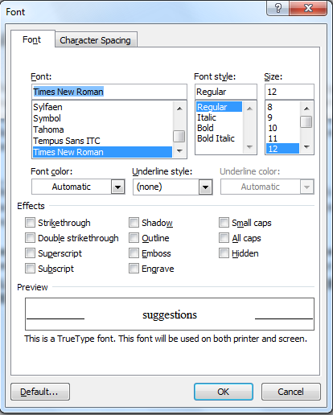
Formatting Text
In the Font dialog box, you can make changes to the type, style, size, and color of font used in the document.
Size
Font
You can change the “handwriting” of your text.
Font style
Put a word in bold or italics for emphasis.
Effects
Will let you add underlining, shadows, or details like strikethrough.
Notes:
The Format menu includes options to change Font, Paragraph, and other style options.
In the Font dialog box, you can make changes to the type, style, size, and color of font used in the document.

Slide 4

Alignment
specify the arrangement of objects, text, and graphics, in predetermined positions using the alignment settings.
align the selected text to the left, right, or center by using the left, right, and center alignment buttons.
Notes:
You can specify the arrangement of objects, text, and graphics, in predetermined positions using the alignment settings. You can align the selected text to the left, right, or center by using the left, right, and center alignment buttons, respectively.

Slide 5
Bullets and Numbering
bullet or numbering options is used to organize information into lists.
Bullets |  | Numbering
 | Aardvark Butterfly Cactus Daffodil |  | Aardvark Butterfly Cactus Daffodil

Slide 6
Indenting and Spacing
Use indentation to offset text away from the margin or bring it closer again.

Slide 7
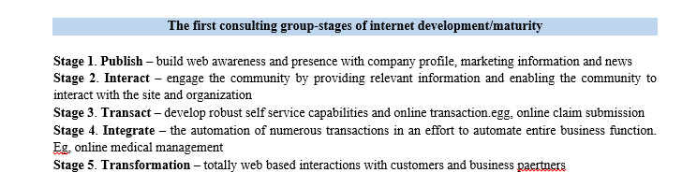

Shading
Change the color behind the selected text, paragraph or table cell.

Slide 8

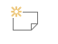
Style
Create a style based on the formatting of the selected text.
Comment
Add a note about this part of the document.

Slide 9


WordArt
Add some artistic flair to your document using a WordArt text box.
Drop Cap
Create a large capital letter at the beginning of a paragraph.

Slide 10
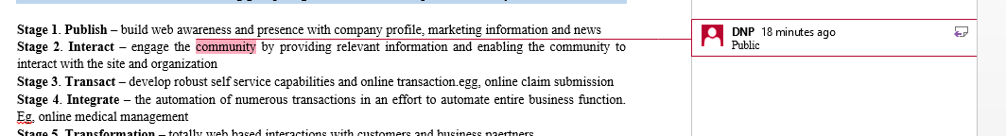
Insert Tab
Comment
  Add a note about part of the document.

Slide 11

Links
Hyperlink
Create a link in your document for quick access to webpages and files.
Bookmark
Bookmarks work with hyperlinks to let you jump to a specific place in your document.
Cross-reference
Refer to specific places in your document, such as headings, figures, and tables.

Slide 12
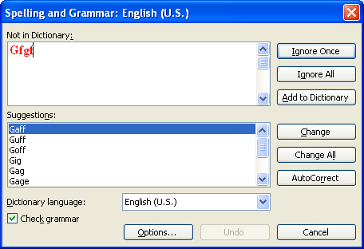
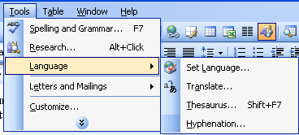
Review Tab
Proofing tools
Spelling checker
  Check both spelling and grammar.
Thesaurus
  A word – finding program that suggests synonyms, antonyms and related and contrasting words.

Slide 13
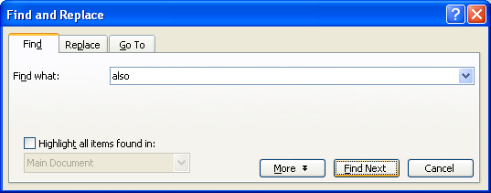
Find, Replace & GOTO
Locate specific words or phrases. Has the ability to search through a document and find a particular section of text or ‘string’ and Replace it with another.
  Select find from the edit menu bar
  Enter the text you want to search for in the dialog box
  Click find Next….

Slide 14
Drag & drop text (move text)
To Select | Action
A word | Double-click the word
A line of text | Move the pointer to the left of the line until it changes to a right- pointing arrow, and then click
Multiple line of text | Move the pointer to the left of the lines until it changes to a right-pointing arrow, and then drag up or down.
A paragraph | Hold down CTRL, and then click anywhere in the sentence.
A paragraph | Move the pointer to the left of the paragraph until it changes to a right-pointing arrow, and then double click. Or triple-click anywhere in the paragraph.

Slide 15
Templates
A template is a pre-designed document that you can use to create new documents with the same formatting.
To Insert a Template:
  Click the Microsoft Office Button.
  Select New. The New Document dialog box appears.
  Select Installed Templates to choose a template on your computer

Slide 16
Mail merge
Mail merge is a useful tool that will allow you to easily produce multiple letters, labels, envelopes ,email messages ,directory and send it to a group of people.
You can personalize the letter that each person receives.

Slide 17
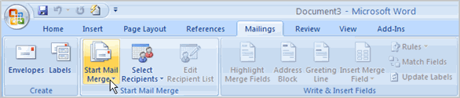
Mail merge
To Use Mail Merge:
  Select the Mailings on the Ribbon.
  Select the Start Mail Merge command.
  Select Step by Step Mail Merge Wizard.
  adsheet.

Slide 18
Macros
Macros are advanced features that can speed up editing or formatting you may perform often in a Word document. They record sequences of menu selections that you choose so that a series of actions can be completed in one step.

Slide 19
Tables
A table is made up of rows and columns of cells.
Can align numbers in columns and then sort and perform calculations on them.

Slide 20
Reference cells
Reference table cells as A1, A2, B1,B2 and so on, with the letter representing a column and the number representing a row.
Eg:
=average(B1:B3)
=sum(A1:A3)
=average(A1,A2,C3)
A B C
1
2
3
A1 | B1 | C1
A2 | B2 | B2
A3 | B3 | C3

Slide 21
Charts
A chart is a graphical representation of data on a worksheet.
It is created as an object that has its own frame or box, and can be independently
  selected,
  moved,
  copied,
  sized and
  formatted
Charts are created from cell values in the worksheet .
Each data series may be created from a row or column in the worksheet.

Slide 22
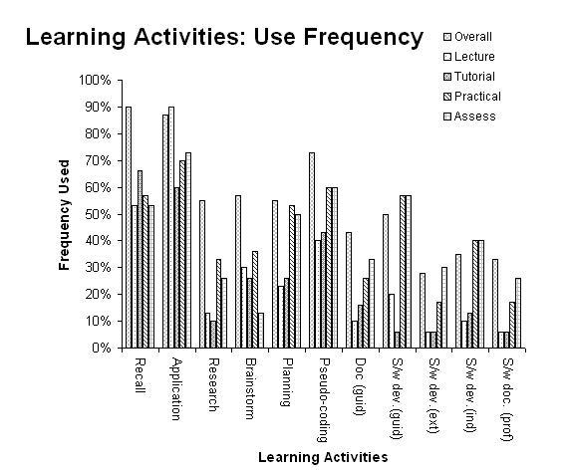
Chart Example
Chart Title
Chart Legend
Value Axis
Value Axis Title
Category Axis
Plot Area
Data Labels (Possibly from data series)
Category Axis Title

Slide 23
Components of a Chart
Chart Title is simply the charts name
Legend tells what each color or symbol in the charts data series represents
Data Series is a range of values in a worksheet
Notes are brief descriptors or explanations of the data in the chart
Data Labels are names that appear along the vertical and horizontal axes to describe the data in the chart

Slide 24
How to Protect a Word 2007 Document
The simplest way to protect a document in Word 2007 is via the Properties menu.
  Right-click the document’s icon and choose Properties. In the Attributes section of the Properties dialog box that appears, enable the Read-only check box and then click OK.

Slide 25
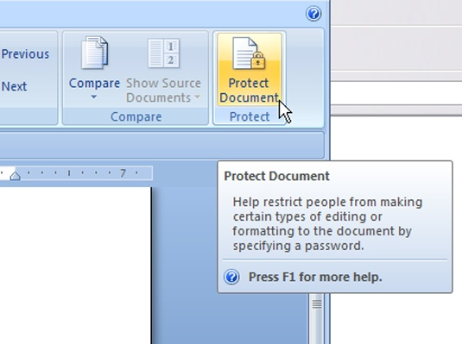
Protect document
On the Review tab of the Ribbon, in the Protect group, click the Protect Document button.
  pane opens on the right side of the document, in which you can set the following:
    Formatting Restrictions: Set the styles to a limited set.
    Editing Restrictions: Allow only certain kinds of changes.
    Start Enforcement: Click this button to begin enforcement.
      In the Start Enforcing Protection dialog box that opens, select one:
      Password
      User Authentication

Slide 26
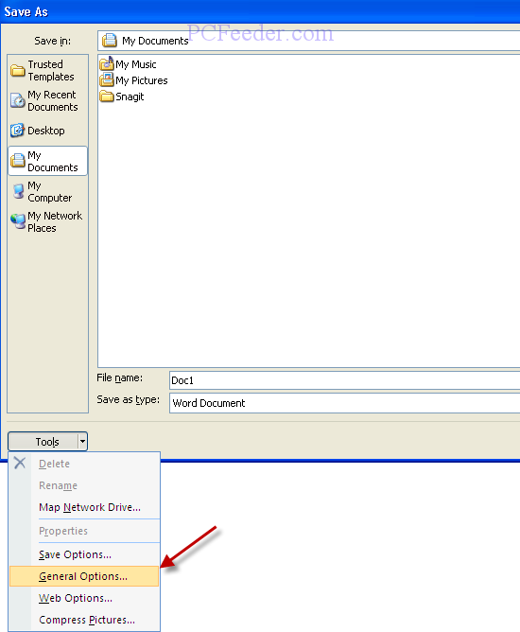
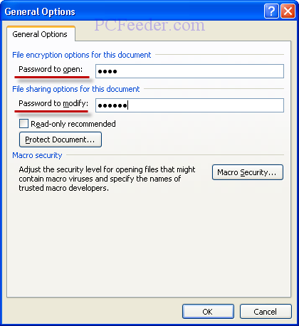
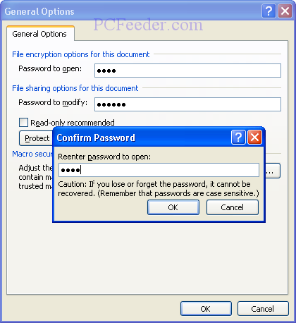
Click the Microsoft Office Button in the upper left corner of Word 2007, click Save As from the left-hand menu, and then save as a Word Document or Word Template
  Click Tools on the Save As pop-up window, and then click General Options.
  You can type a password in Password to open text box.

Slide 27
Backup
Select "File" from the top menu bar and choose "Word Options." A dialogue box will appear.
Click "Advanced" on the right-hand side navigation panel. Scroll down, using the mouse, to the "Save" section of the dialogue box. Select "Always create backup copy" and click "OK." A backup copy of your files will be saved as you work.

Slide 28
End

Slide 29
End

